Slide 1


Marketing Environment & Market research
Lecture 2

Slide 2




MARKETING ENVIRONMENT
Chapter 3

Slide 3
Learning Objective
Understand some of the major forces in a company’s micro- and macroenvironment

Slide 4
ORGANIZATION
1. Introduction
2. Micro-environment
3. Macro-environment
4. Marketing Opportunities

Slide 5
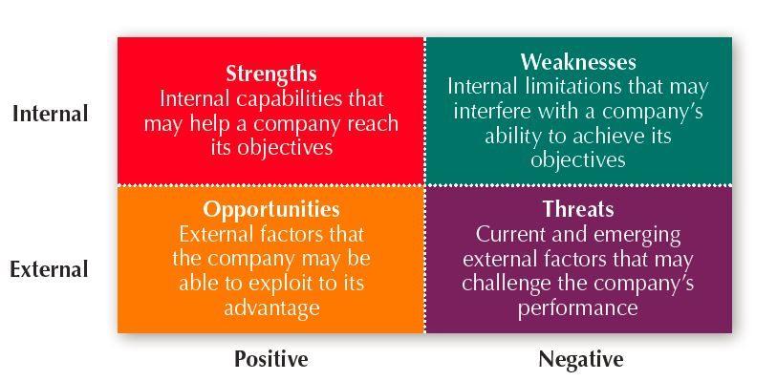
Managing the Marketing Effort
Market Planning—Parts of a Marketing Plan
Executive summary
Situation Analysis
SWOT
Competitor Analysis
Objectives and issues
Marketing strategy
Action programs
Budgets
Controls

Slide 6
INTRODUCTION
Diverse, dynamic, & uncontrollable forces external to firm’s marketing management function affecting its operations & opportunities
Microenvironment: Actors in firm’s immediate environment affecting its ability to serve its customers
Macroenvironment: Larger societal forces affecting all actors in firm’s microenvironment

Slide 7
SWOT Analysis
Strengths What is our company doing better than others? What do other people think our strengths are? What unique resources do we have? | Weaknesses What do we do a poor job of? What do other people think about our shortcomings? What does our Accountant / Financial officers think our biggest problems are in terms of our finances, costs and resource allocation?
Opportunities Ride of the opportunities available from current trends or popular consumer habits / business practices. What trends should you pay attention to that you can take advantage of? What new products/services can we sell? | Threats What are the major threats to your business and industry? What should we be afraid of in the coming future (next 6 months / 1 year)? What major trends are we not utilizing? Where can our competition crush us?
Notes:
Source: https://kopywritingkourse.com/guides/how-to-do-a-swot-analysis/

Slide 8
Competitor Analysis
Assess & analyse the competitors
If a company wants to enter a new market or wants to launch a new product, the company may consider using the Porter’s 5 Forces Analysis
Barriers of entry (does the firm require high capital investment requirements to enter? Country’s laws/regulations?)
Competitors (how strong/weak?)
Substitutes (good/poor substitutes?)
Suppliers (reliability, credit-worthiness, good biz practices)
Buyers (willing to spend on your product?)

Slide 9
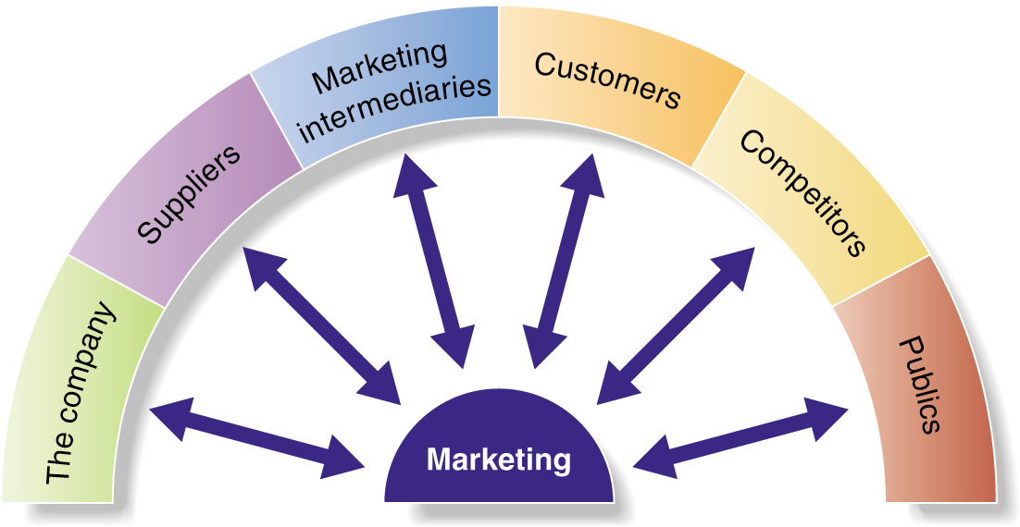
Micro-environment
What affects the micro-environment of a company?
Suppliers
Marketing intermediaries
Competitors
Publics
To be covered under Consumer Behavior

Slide 10

Micro-environment factors
Supplier
Firms & individuals providing the resources required by the company & its competitors
Affect costs & availability of supply
Maintain good buyer-seller relations
Multiple sourcing
Marketing Intemediaries
Firms aiding the company in promoting & distributing its goods to final buyers
Physical distribution firms, trade members, & marketing services agencies (e.g., ad agencies)
Competitors
Know the customers and analyse what they do
What are they doing right or wrong? What are they doing that you are not doing?
Publics
Group with actual or potential interest or impact on firm’s ability to achieve its objectives
Citizen action (e.g., CASE), media, financial, & internal publics

Slide 11
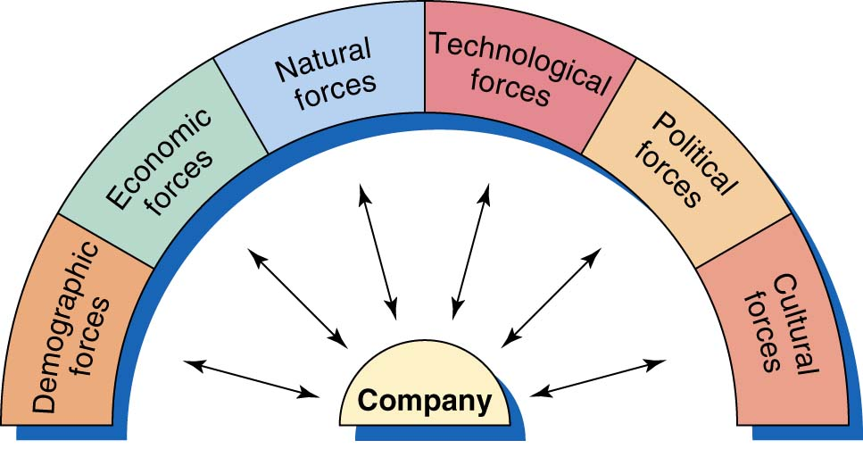
Macro-environment
6 major sectors

Slide 12
Macro-environment factors
Demographics
Age distribution & family changes
Geographic population shifts
Better education
Working women
Economic
General conditions (e.g., inflation, recession)
Changes in real income & expenditure patterns
Environmental
Energy, pollution, & shortages of natural resources
Ethical and environmental concerns
Technological
Advancements in technology for product & service improvements
Smart technologies – artificial intelligence (AIs), augmented reality (AR) & virtual reality (VRs)
Increase in digital services
Political/Legal
Government & statutory boards (laws, taxes, competition, & privatization)
Social-cultural
Multi-racial/cultural society
Pop culture & lifestyle
Sub-cultures
Modernisation

Slide 13
Managing MARKETING information
Chapter 4

Slide 14
Learning objectives
Know the concept and components of a Marketing Information System
Know the steps of marketing research process & their contribution to providing management with actionable data
Know the characteristics of good marketing research

Slide 15
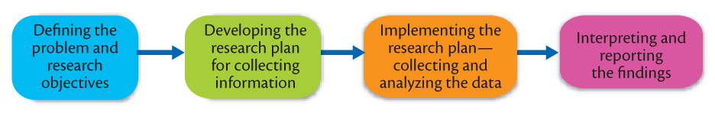
What does market research involve?
Process of market research
Introduction
Research description & purpose
Research Objectives
Define the problem & research objectives
Research Design & Implementation
Implementing the research plan
Data collection
Research Output
Findings and analysis

Slide 16
Why conduct market research?
Systematic design, collection, analysis, & reporting of data & findings relevant to a specific marketing situation facing firm
Examples of reasons for conducting marketing research
Estimates of market potentials
Sales volume forecasts
Which types of purchasers account for the largest percentage of total units sold
How the product is actually used by the market

Slide 17
Research objectives
Identify managerial problem & translate into specified set of variables to be studied
Close co-operation between marketing manager & researcher needed

Slide 18
Defining the Problem & Objectives
Exploratory
Research
Gather preliminary information
that will help define the problem
and suggest hypotheses
Descriptive
Research
Describes things (e.g., market
potential for a product,
demographics, and attitudes)
Causal
Research
Tests hypotheses about
cause-and-effect
relationships

Slide 19
Research Design & implementation
Set of methods & procedures used to collect & analyze measures of variables specified in research problem
Primary data source
Secondary data source
Existing data generated for a problem other than the one at hand
Advantages:
Quicker
Cheaper
Particularly useful in early stages of research
Disadvantages:
Unavailability –
Inaccessibility –
Irrelevant
Inaccurate
Out-dated
Bias
Original data specifically collected for the problem at hand
Methods of primary data collection

Slide 20
Types of Primary Research
Type of Study | Description | Options | Advantages | Disadvantages
Observation | Study phenomenon in its natural setting | Direct observation Ethnographic analyses Mechanical observation Physical traces | Valid measures | Limited scope of variables
Survey | Study characteristics of population through questionnaire | Personal interview Telephone interview Mail questionnaire Drop-off questionnaire Focus group | Wide scope of information can be gathered | Costly Wide scope of expertise needed
Experiment | Test causal relationship between variables | Field experiments Laboratory expts | Deep level of inquiry that contributes to understanding | Realism difficult to achieve in lab Control difficult to achieve in field
Focus Group | A small, but demographically diverse group of people and whose reactions are studied | Small group interview setting | Good insights and deep level of inquiry | Facilitator bias

Slide 21
Research design & implementation
Sampling
Set of procedures used to determine sample size & composition
Key Decisions:
1. Sampling Unit: Who to survey?
2. Sample Size: How many to survey?
3. Sampling Procedure: How to select them?

Slide 22
Research design & implementation
Data collection, processing & analysis
Collecting data often most expensive & error prone phase
Biases
Questions
“What is your monthly income?”
“Would you donate to charity?”
Standing in front of shop for surveys
Interviewer bias
Coding data
Checking for accuracy
Statistical analysis

Slide 23
Research output
This is the final phase of report evaluation. The analysis aims to interpret & report findings. Information can be used to:
Monitor environment
More brands were mentioned by respondents. Does this mean more competition?
Implement marketing concept
Understand better what customers want
Formulate & evaluate market segments
Is there a growing segment?
Is there a decreasing segment?
Assess demand
How likely are people to buy my product?
How much would they pay for my product?
How many units would they buy?
Evaluate marketing tactics & performance
Recall, attitude, perception of brand after ad campaign

